Slide 1


CAPSTONE PROJECT
HR Analytics and Attrition Dashboard
Presented By
Student Name: NIRANJANA B
College Name: R.M.D ENGINEERING
Department: CSE
Email ID:23102142@rmd.ac.in,
niranjanadec12@gmail.com

Slide 2
OUTLINE:
Problem Statement
Proposed System/Solution
System Development Approach
Algorithm & Deployment
Result (Output Image)
Conclusion
Future Scope
References

Slide 3
Problem Statement:
Employee attrition is a major challenge for organizations, leading to increased hiring costs, loss of skilled employees, and reduced productivity. Existing HR analytics dashboards mainly focus on historical data such as attrition count and attrition rate, which only explain what has already happened. HR teams face difficulty in identifying employees who are likely to leave in the future and understanding which factors contribute most to attrition. The lack of predictive insights and actionable analysis makes it hard for HR managers to take timely preventive measures to reduce employee turnover.

Slide 4
Proposed Solution:
The proposed system introduces an HR Analytics and Attrition Dashboard using Power BI with a Rule-Based Attrition Risk Prediction approach. The system evaluates employee data using predefined HR rules based on factors such as years of experience, salary hike, job satisfaction, overtime, and distance from home. Each risk factor contributes to a risk score, and employees are classified into Low, Medium, and High Attrition Risk categories. This rule-based approach is simple, transparent, and easy to understand, enabling HR teams to proactively identify high-risk employees and support data-driven retention decisions through interactive dashboard visualizations.

Slide 5
System Approach:
Tools & Technologies:
Power BI Desktop – Data modeling, DAX calculations, and dashboard creation
Microsoft Excel / CSV Dataset – Data source
DAX (Data Analysis Expressions) – Risk scoring logic and KPIs
Development Approach:
Data collection and cleaning
Data modeling in Power BI
Creation of calculated columns and measures
Design of interactive dashboards
Validation of results through visuals

Slide 6
Algorithm & Deployment:
Attrition Risk Scoring (Rule-Based):
HR factors used: Years at Company, Salary Hike, Job Satisfaction, Overtime, Distance from Home
1 risk point assigned for each risk condition met
Total risk score calculated per employee
Risk Levels:
  0–1: Low Risk 2: Medium Risk 3+: High Risk
Deployment:
Dashboard developed in Power BI Desktop
Can be published to Power BI Service for organizational access

Slide 7
Result:
Built an interactive HR Attrition Dashboard using Power BI
Employees are grouped into Low, Medium, and High Attrition Risk
HR can quickly identify high-risk employees using clear visuals
Supports data-driven and proactive HR decisions

Slide 8
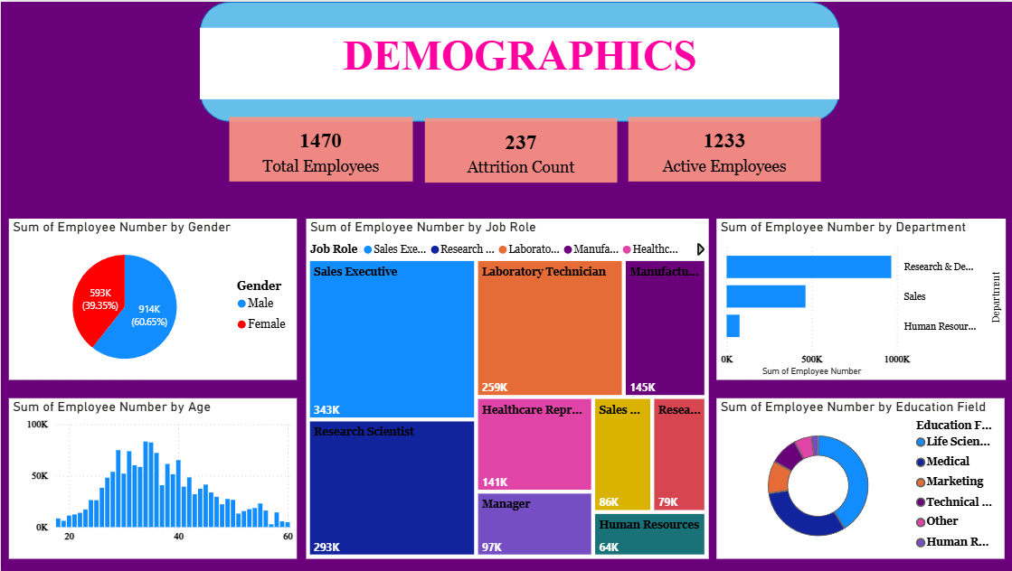
Result:

Slide 9
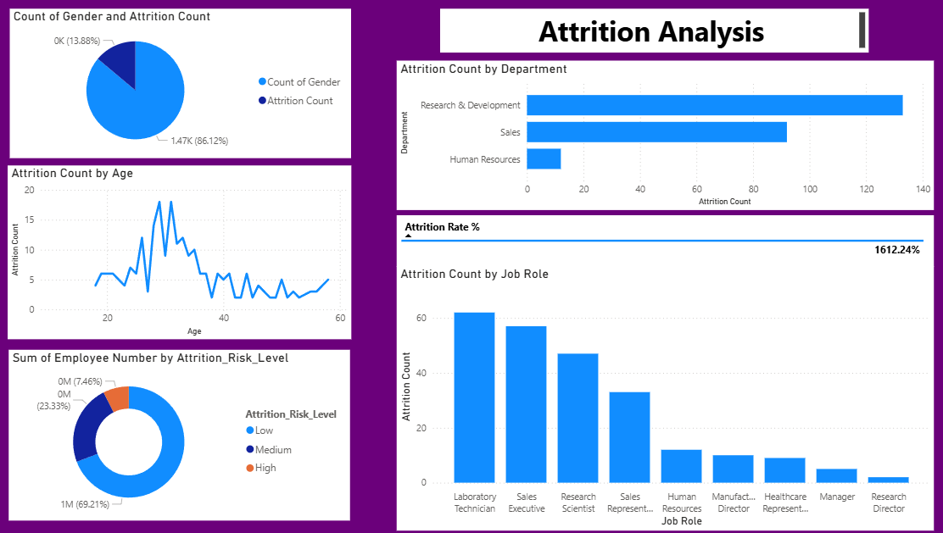
Result:

Slide 10
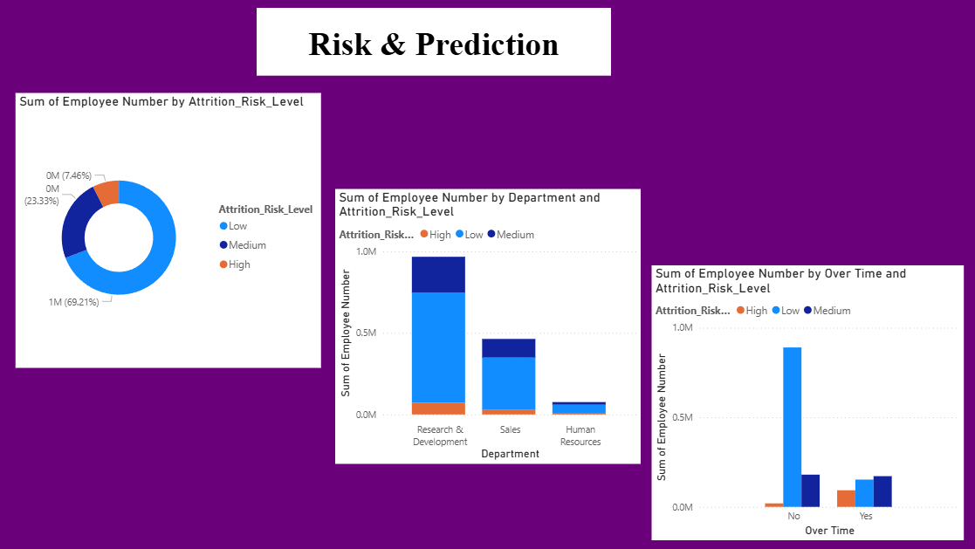
Result:

Slide 11
Conclusion:
The HR Analytics and Attrition Dashboard successfully provides meaningful insights into employee attrition using a rule-based risk prediction approach. By analyzing key HR factors and visualizing them through Power BI, the system helps HR teams easily identify high-risk employees, understand attrition patterns, and support proactive retention strategies. The solution is simple, transparent, and effective for real-world HR decision-making.

Slide 12
Future scope:
In the future, the HR Analytics and Attrition Dashboard can be enhanced by integrating machine learning models to predict attrition more accurately. Additional HR factors such as performance ratings, training hours, and employee engagement scores can be included for deeper analysis. The dashboard can also be deployed on Power BI Service for real-time monitoring and automated alerts, enabling HR teams to take faster and more proactive retention actions.

Slide 13
References:
https://ieeexplore.ieee.org/document/11216811
https://ieeexplore.ieee.org/document/11089919
https://ieeexplore.ieee.org/document/11323687
GitHub Link: https://github.com/Niranjanadec12/HR-Analytics-and-Attrition-Dashboard.git

Slide 14
Thank You

